Slide 1
Control Double Inverted
Pendulum by Reinforcement Learning
Course: EEE Msc
Name: Peter Huang

Slide 2
OUTLINE
Introduction & Aim
Pendulum Movement
Reinforcement Learning
Schedule Assign

Slide 3
Introduction
Due to the increasing complexity of system
-Adaptive the environment
-Optimize the performance
Aim
- Analysis the learning performance
- Analysis the control performance
- Step respond
Fig 1. Inverted Pendulum

Slide 4
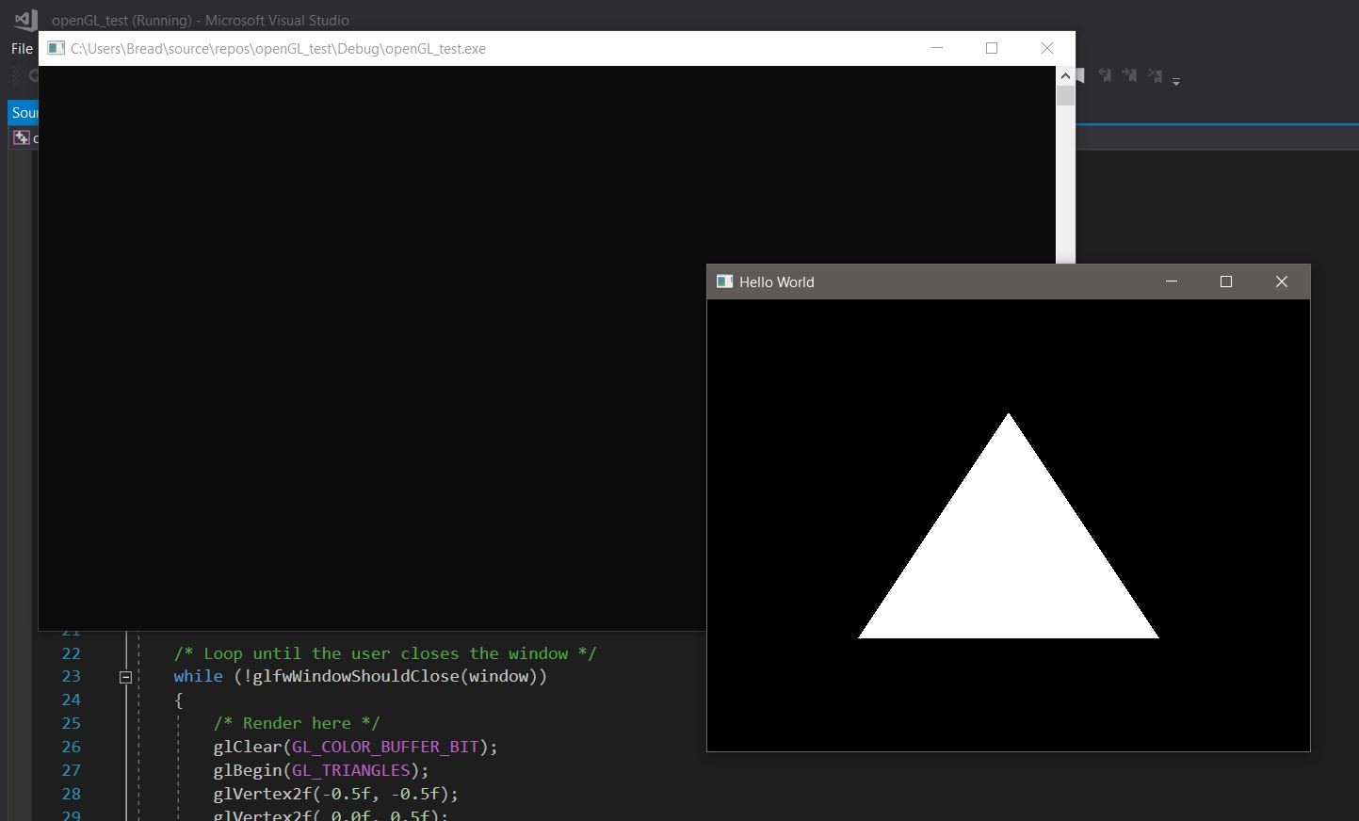
Pendulum Movement
Simulation in C
-Understand the kinetic and potential
energy
- OpenGL and Cimg
- Simulation the single pendulum
movement
-Combine a Force input
Fig 2. Movement Energy
Fig 2. Movement Energy
Source: https://www.myphysicslab.com/pendulum/double-pendulum-en.html

Slide 5
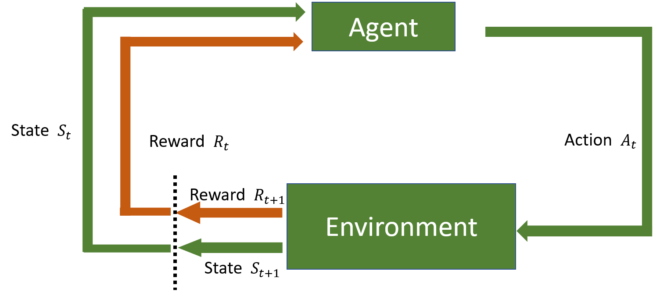

Reinforcement Learning
Based on Darwin theory
- Interact with environment
- Optimize by getting the best reward
- Two common class
- Model- Based
- Model-Free
Fig 3. Markov decision process
Source: http://www.techplayon.com/5g-mmwave-spectrum/

Slide 6
Schedule Assign
Component | 1 | 2 | 3 | 4 | 5 | 6 | 7 | 8 | 9 | 10 | 11 | 12 | Exam Week |  |  | 16 | 17 | 18 | 19 | 20 | 21 | 22
Background research on RL
Project initialisation document
Study the theory of movement in pendulum
Learning OpenGL library in C
Simulate the movement of pendulum
Second marker meeting
Reinforcement learning algorithm design (using C)
Evaluation and performance improvement
Interim Report
Second viva
IEEE style Report

